Slide 1
Chapter 11
Introduction to
Programming in C

Slide 2
C: A High-Level Language
Gives symbolic names to values
  don’t need to know which register or memory location
Provides abstraction of underlying hardware
  operations do not depend on instruction set
  example: can write “a = b * c”, even though
  LC-3 doesn’t have a multiply instruction
Provides expressiveness
  use meaningful symbols that convey meaning
  simple expressions for common control patterns (if-then-else)
Enhances code readability
Safeguards against bugs
  can enforce rules or conditions at compile-time or run-time

Slide 3
Compilation vs. Interpretation
Different ways of translating high-level language
Interpretation
  interpreter = program that executes program statements
  generally one line/command at a time
  limited processing
  easy to debug, make changes, view intermediate results
  languages: BASIC, LISP, Perl, Java, Matlab, C-shell
Compilation
  translates statements into machine language
    does not execute, but creates executable program
  performs optimization over multiple statements
  change requires recompilation
    can be harder to debug, since executed code may be different
  languages: C, C++, Fortran, Pascal

Slide 4
Compilation vs. Interpretation
Consider the following algorithm:
  Get W from the keyboard.
  X = W + W
  Y = X + X
  Z = Y + Y
  Print Z to screen.
If interpreting, how many arithmetic operations occur?
If compiling, we can analyze the entire program and possibly reduce the number of operations. Can we simplify the above algorithm to use a single
arithmetic operation?

Slide 5
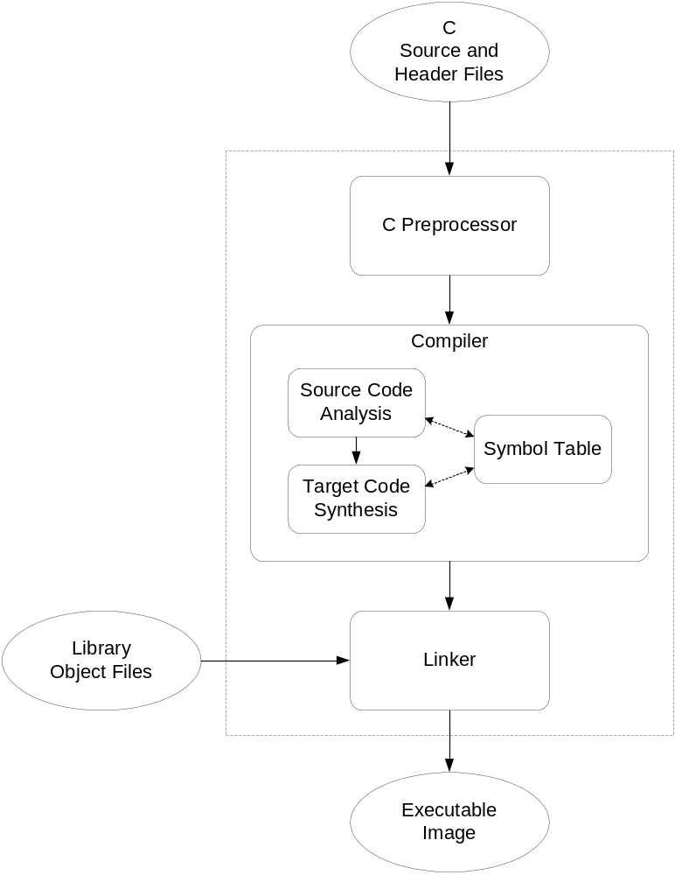
Compiling a C Program
Entire mechanism is usually called
the “compiler”
Preprocessor
  macro substitution
  conditional compilation
  “source-level” transformations
    output is still C
Compiler
  generates object file
    machine instructions
Linker
  combine object files
  (including libraries)
  into executable image

Slide 6
Compiler
Source Code Analysis
  “front end”
  parses programs to identify its pieces
    variables, expressions, statements, functions, etc.
  depends on language (not on target machine)
Code Generation
  “back end”
  generates machine code from analyzed source
  may optimize machine code to make it run more efficiently
  very dependent on target machine
Symbol Table
  map between symbolic names and items
  like assembler, but more kinds of information

Slide 7
A Simple C Program
#include <stdio.h>
#define STOP 0
/* Function: main */
/* Description: counts down from user input to STOP */
main()
{
/* variable declarations */
int counter; /* an integer to hold count values */
int startPoint; /* starting point for countdown */
/* prompt user for input */
printf("Enter a positive number: ");
scanf("%d", &startPoint); /* read into startPoint */
/* count down and print count */
for (counter=startPoint; counter >= STOP; counter--)
printf("%d\n", counter);
}

Slide 8
Preprocessor Directives
#include <stdio.h>
  Before compiling, copy contents of header file (stdio.h)
  into source code.
  Header files typically contain descriptions of functions and
  variables needed by the program.
    no restrictions -- could be any C source code
#define STOP 0
  Before compiling, replace all instances of the string
  "STOP" with the string "0"
  Called a macro
  Used for values that won't change during execution,
  but might change if the program is reused. (Must recompile.)

Slide 9
Comments
Begins with /* and ends with */
Can span multiple lines
Cannot have a comment within a comment
Comments are not recognized within a string
  example: "my/*don't print this*/string"
  would be printed as: my/*don't print this*/string
As before, use comments to help reader, not to confuse
or to restate the obvious

Slide 10
main Function
Every C program must have a function called main().
This is the code that is executed
when the program is run.
The code for the function lives within brackets:
main()
{
/* code goes here */
}

Slide 11
Variable Declarations
Variables are used as names for data items.
Each variable has a type,
which tells the compiler how the data is to be interpreted
(and how much space it needs, etc.).
int counter;
int startPoint;
int is a predefined integer type in C.

Slide 12
Input and Output
Variety of I/O functions in C Standard Library.
Must include <stdio.h> to use them.
printf("%d\n", counter);
  String contains characters to print and
  formatting directions for variables.
  This call says to print the variable counter as a decimal integer, followed by a linefeed (\n).
scanf("%d", &startPoint);
  String contains formatting directions for looking at input.
  This call says to read a decimal integer and assign it to the
  variable startPoint. (Don't worry about the & yet.)

Slide 13
More About Output
Can print arbitrary expressions, not just variables
printf("%d\n", startPoint - counter);
Print multiple expressions with a single statement
printf("%d %d\n", counter,
startPoint - counter);
Different formatting options:
%d decimal integer
%x hexadecimal integer
%c ASCII character
%f floating-point number

Slide 14
Examples
This code:
printf("%d is a prime number.\n", 43);
printf("43 plus 59 in decimal is %d.\n", 43+59);
printf("43 plus 59 in hex is %x.\n", 43+59);
printf("43 plus 59 as a character is %c.\n", 43+59);
produces this output:
43 is a prime number.
43 + 59 in decimal is 102.
43 + 59 in hex is 66.
43 + 59 as a character is f.

Slide 15
Examples of Input
Many of the same formatting characters are
available for user input.
scanf("%c", &nextChar);
  reads a single character and stores it in nextChar
scanf("%f", &radius);
  reads a floating point number and stores it in radius
scanf("%d %d", &length, &width);
  reads two decimal integers (separated by whitespace),
  stores the first one in length and the second in width
Must use ampersand (&) for variables being modified.
(Explained in Chapter 16.)

Slide 16
Compiling and Linking
Various compilers available
  cc, gcc
  includes preprocessor, compiler, and linker
Lots and lots of options!
  level of optimization, debugging
  preprocessor, linker options
  intermediate files --
  object (.o), assembler (.s), preprocessor (.i), etc.

Slide 17
Remaining Chapters
A more detailed look at many C features.
  Variables and declarations
  Operators
  Control Structures
  Functions
  Data Structures
  I/O
Emphasis on how C is converted to
LC-3 assembly language.
Also see C Reference in Appendix D.

